Slide 1
Project lll
Toqa Mahmoud , Khadiga Iraky, Adham Salem
17/3/2025

Slide 2
DATE
Roles of every team member
Descriptions and pseudo-code of the 2 compute functions
Simple examples showing the 2 compute functions producing correct results.
In parallel_compute, design a figure illustrating the processes and the pipes as well as the direction of flow of data.
How the 2 tests are designed (e.g., ranges chosen).
Method of curve smoothing.
Comparison results and answers to the 2 questions

Slide 3
Each Member Role
Toqa : Sequential Compute
Khadiga : Parallel Compute
Adham : Comparing Sequential & Parallel Compute

Slide 4
Descriptions and pseudo-code of the 2 compute functions
Name
Department Course Number Section Time Location
DATE
Sequential Compute Program Description
This program reads numbers from a file sequentially and computes a cumulative result by applying a binary operation (in this case addition) to all numbers. The program processes the numbers one after another, maintaining a running result.

Slide 5
Descriptions and pseudo-code of the 2 compute functions
Pseudo Code
Function sequential_compute(filename, operation):
Open file
If file not found:
Print error
Return error code
Initialize result
Initialize first_number flag = true
While there are numbers in file:
Read current_number
If first_number:
result = current_number
first_number = false
Else:
result = operation(result, current_number)
Skip any spaces or commas
Close file
Return result
Function add(a, b):
Return a + b
Main Function:
If no filename provided in arguments:
Print usage instructions
Exit with error
Call sequential_compute with filename and add function
Print result

Slide 6
Descriptions of the Parallel Compute Function
Name
Department Course Number Section Time Location
DATE
Parallel Compute Program Description
This C program reads integers from a file, distributes the required computation across different child processes using pipes and forked processes, as determined by the number of process the user enters. It finds the maximum integer. The function dynamically allocates memory for the input data, partitions it among child processes based on the number of CPU cores, and uses pipe-based communication to collect and reduce the results.

Slide 7
Parallel Compute Pseudo-Code
FOR each core i
IF fork() == child THEN
CLOSE read end of pipe
Allocate memory for chunk
Copy chunk of data from array
Compute max of chunk
WRITE result to pipe
CLOSE write end of pipe
EXIT child process
ELSE IF fork fails THEN
PRINT "Fork error"
EXIT
END FOR
FOR each core i
CLOSE write end of pipe
END FOR
READ first child's result as realAns
FOR each remaining core i
READ result from pipe
realAns = biggerFunction(realAns, result)
END FOR
WHILE waiting for children
PRINT "Child process finished"
FREE allocated memory
RETURN realAns
END FUNCTION
FUNCTION biggerFunction(a, b)
RETURN maximum of a and b
END FUNCTION
FUNCTION parallelCompute(fileName, f)
OPEN file
IF file cannot be opened THEN
PRINT "File error"
EXIT
ALLOCATE memory for array
WHILE reading numbers from file
STORE number in array
RESIZE array if needed
END WHILE
CLOSE file
PRINT "File loaded!"
PRINT "Enter number of cores: "
READ coreNum
chunkSize = totalNumbers / coreNum
remainder = totalNumbers % coreNum
CREATE pipes for communication

Slide 8
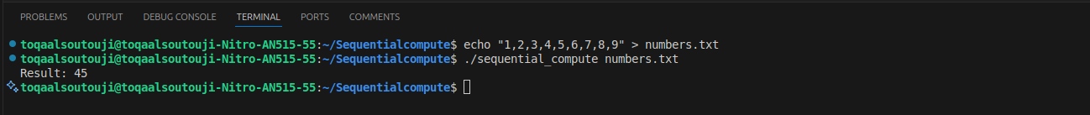
Simple examples showing the 2 compute functions producing correct results.
Sequential Compute

Slide 9
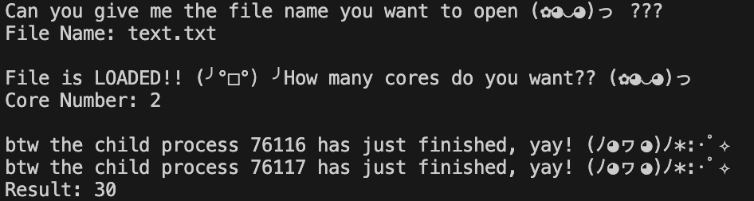
Showing Correct Results
Parallel Compute
10,5,20,8,15,7,25,30,12,18

Slide 10
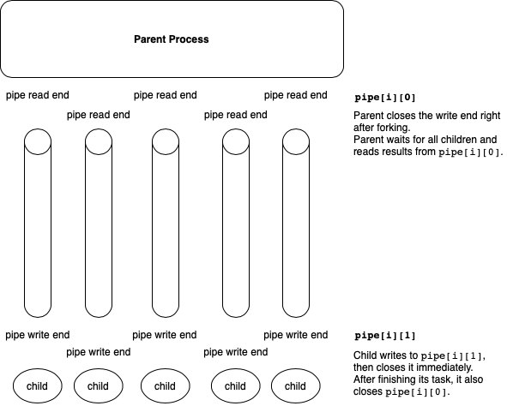
Parallel Compute

Slide 11
Curve Smoothing
Name
Department Course Number Section Time Location
DATE
The window size determines how many adjacent data points are used to compute the smoothed value.
A larger window size leads to smoother data (removes noise but can blur sharp transitions).
A smaller window size retains more details but does less noise reduction.
The median filter replaces each point with the median of the neighboring values within the window.
For example:
Raw Data: 1.20 1.30 1.80 2.20 2.50 3.00 2.90 3.50 3.80 4.00
Smoothed Data: 1.20 1.25 1.43 1.77 2.17 2.57 2.80 3.13 3.40 3.77
The first value does not change as there is no previous data
The second value is the average of the first two values.
From the third value onward, we compute the average over the last 3 values.
This reduces sudden spikes or dips, making the data smoother.

Slide 12
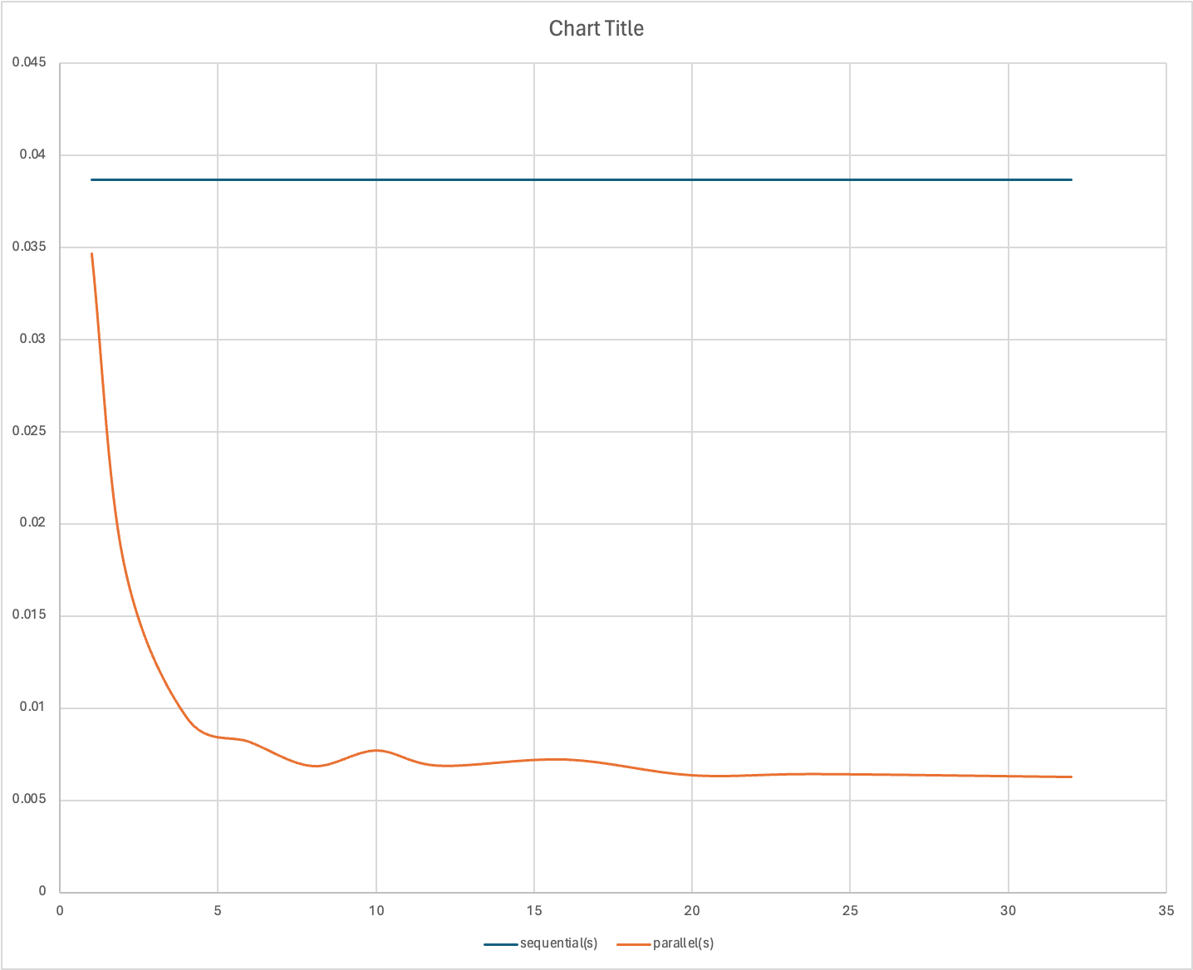
Having A fixed N = 10000
Name
Department Course Number Section Time Location
DATE
If we fix N to a large number, then at which value of n_proc does parallel_compute outperform sequential_compute?
So the best is having 8 cores

Slide 13
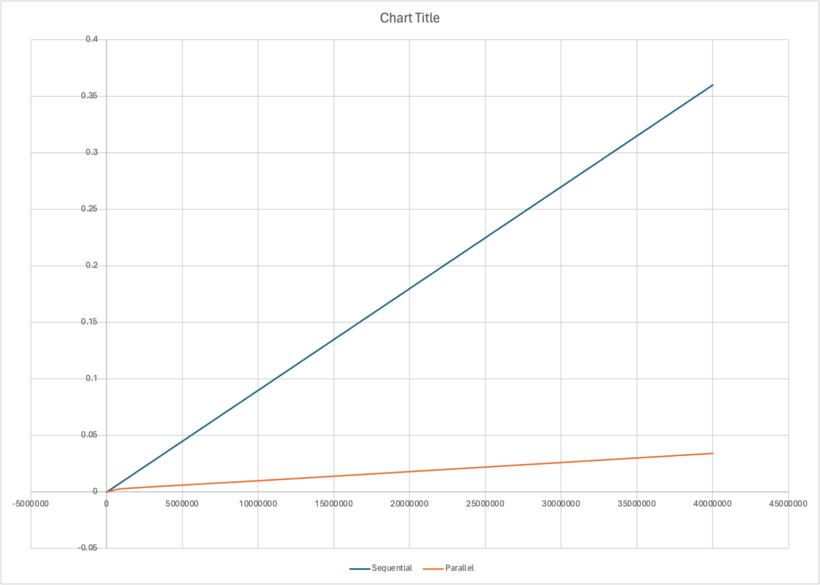
Having fixed n_proc =6
If we fix n_proc, then at which value of N does parallel_compute outperform sequential_compute?
So as we see parallel wins

